Slide 1


Slide 2

A
Presentation on
Environmental Impact Assessment
Submitted to: Dr. S. Nath Submitted By: Saurabh Upadhyay
Asst. Prof. School of Forestry and Environment
DEPARTMENT OF ENVIRONMENTAL SCIENCE
School of Forestry and Environment
Sam Higginbottom Institute of Agriculture, Technology & Sciences
Notes:
sU

Slide 3
What is EIA?
A process which attempts to identify and predict the impacts of proposals, policies, programs, projects and operational procedures on the biophysical environment and on human health and well-being
It also interprets and communicates information about those impacts and investigates and proposes means for their management
A planning and decision-making tool to protect the natural environment and, thereby, protect human societies

Slide 4
What is EIA?
A process which attempts to identify and predict the impacts of proposals, policies, programs, projects and operational procedures on the biophysical environment and on human health and well-being
It also interprets and communicates information about those impacts and investigates and proposes means for their management
A planning and decision-making tool to protect the natural environment and, thereby, protect human societies

Slide 5
Why do EIA?
Promotes better planning and leads to more responsible decision making; ensures that renewable and non-renewable resources are used wisely
Evaluates the rationale behind proposed projects and activities; are there alternatives to a proposed project or activity?
Assists in pursuing sustainable development by evaluating alternatives means of undertaking proposed projects and activities

Slide 6
Why do EIA? (Cont’d)
Assessment outputs facilitate informed decision making; anticipated environmental impacts can be weighed against economic benefits and other social gains in deciding whether to approve or reject proposals
Helps to identify and understand environmental impacts early in the project cycle; predicted impacts can be mitigated before they occur
Provides opportunity for input from interested parties; increases likelihood of public acceptance

Slide 7
Why is EIA Needed?
The natural environment is the foundation of the world economy and our social well-being
Past development practices have severely degraded the natural environment and wasted scarce resources
Increasing development pressures (e.g., industrialization, urbanization, and resource use) will inevitably accelerate environmental degradation unless sustainable environmental management practices are adopted

Slide 8
Why is EIA Needed?
The natural environment is the foundation of the world economy and our social well-being
Past development practices have severely degraded the natural environment and wasted scarce resources
Increasing development pressures (e.g., industrialization, urbanization, and resource use) will inevitably accelerate environmental degradation unless sustainable environmental management practices are adopted

Slide 9
Aims and objectives of EIA
There are different aims of EIA that will influence the choice of method and the scope of the study. The aim is dependent on who is the user as well as on the use of the result. Some of the aims may be regarded as more or less formal like:
• Project development. The use of EIA in project development may be regarded as a way of avoiding environmental impacts by using EIA at as early stage as possible in the development. This is also a way of avoiding costs due to these impacts. This may be used for different projects e g construction or reconstruction of industrial plants, construction of roads, and construction of municipal waste or water purification plants. The users are to be found in the decision makers in the company and the performer is usually the project team or consultants.
• Development control (licenses, permits etc). Here the EIA is a tool for authorities to prevent adverse environmental impact from the kind of projects mentioned above. This kind of EIA has been introduced in national legislation. The performer may be the authority but also it may be the task of the performing company. Also here consultants may be used for the work.

Slide 10
Plan development. This EIA is a tool for authorities in planning of resource or land use, infrastructure like roads, railways etc. This EIA often is called Strategic Environmental Assessment (SEA). The authority may be performer if the competence is available, else consultants are used.
• Policy development. Another use of SEA is in policy development were the consequences of a policy can be evaluated by a government. As an example a government may evaluate the consequences of promoting a specific type of industry (forest industry or IT.) as a major primary industry. Also here the work may be performed internally or by consultants.

Slide 11
Types
Most impact analysis methods can be divided into the following seven types.
checklists
matrices
networks
overlays
Models
quantitative
ad hoc
workshop

Slide 12
Roles and perspectives in EIA
Since there are many persons of different categories involved in an EIA in various ways, the perspective on what an EIA is may vary. The following list is hypothetical, but may be used to illustrate what an EIA may mean to different categories (after Morgan 1998):
• Environmental scientist - a process that predicts a likely change in the environment (eg: fish population, air quality etc)
• Sociologist - a process of informing local communities about changes in the environment allowing the population to participate in the decision-making.
• Member of the local community - a way for the council and developers to justify a development project.

Slide 13
• Consultant - a job
• Political scientist - a process that forces bureaucracies to recognise and respond to concerns about environmental change
• Politician - a process that demonstrates that decision-making recognizes environmental issues
• Developer - a process which allows the local authorities to employ more people
• "Deep" ecologist - a process that allows the government and developers to maintain long term policy of resource development and growth without concern for the environment
• Planner - a practical process for balancing the needs of development with the need to maintain important environmental and social characteristics of a locality
• Economist - a process for identifying externalities associated with a proposal and assign them monetary values

Slide 14
Principles and methodology of EIA
The EIA process involves a number of steps. The process is, like all learning processes, cycli. A suggested sequence of EIA steps is illustrated in Figure 1, where the arrows indicate possible iterations.
There is no standardized methodology of EIA as there is for instance for LCA. However, a framework of principles to guide strategies, methods and techniques has been more or less recognised by the scientific community and included in legislation and directives in various countries and in the EU. Thus, this is not a prescriptive, step-by step guide to perform EIA, but it reflects the recommendations that are common in many countries for EIA studies and reflects the scientific demands on EIA.
The EIA process may be described as a number of steps, the contents of which are dependent on the purpose and nature of the study. There is a large component of iteration in the process as is shown in Figure 1.

Slide 15
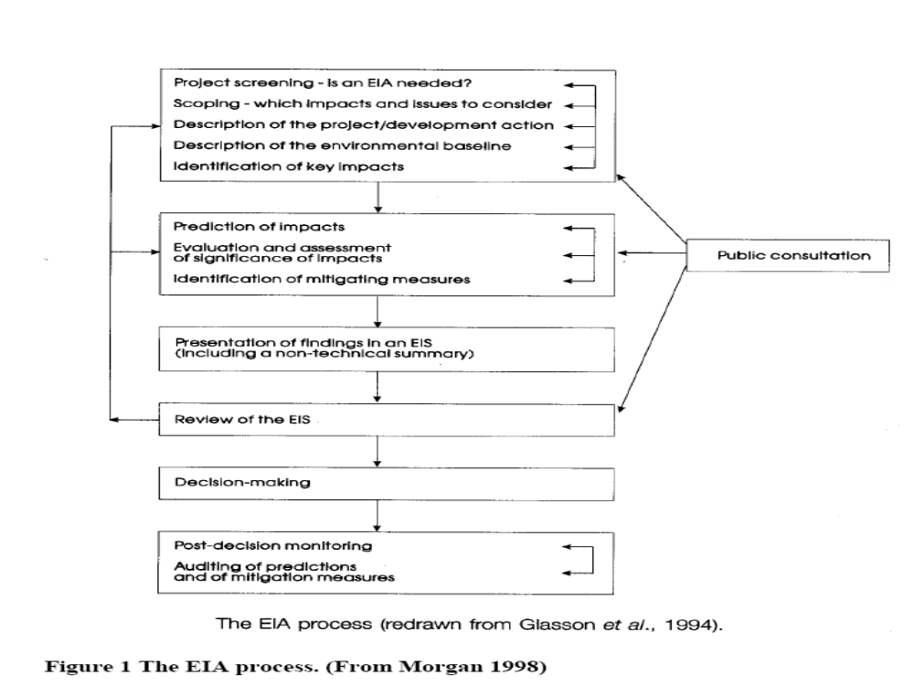

Slide 16
Impact identification
Impact identification is establishing the basis for designing appropriate and efficient EIA studies, focused on particular impact areas. The purpose of impact identification is not to produce definitive statements about the nature, magnitude and significance of possible impacts. The assessor should not be trying to reach definitive conclusions during scoping but should be using the scoping process to organise the main EIA investigations to generate information on these issues.
The impact identification has been subject of a large number of proposed methods and techniques. These have often been called EIA techniques and have often been considered (or misinterpreted) to constitute the complete EIA. This has spread the view that EIA is a technical exercise and that the purpose of an EIA could be satisfied by using one or more of the techniques in a mechanical manner. However, the methods constitute useful aids in the identification of impacts in a structured and systematic way. The task of making decisions about the possible impacts and their importance still lies with the assessor.

Slide 17
Checklists
A common, simple and inexpensive method is the checklist. These can be of different types. Below are the most common listed:
Simple checklists list the components or aspects, usually of the environment, that might be considered by the assessor, but no other assistance is provided to guide the impact identification process.
Descriptive checklists provide additional assistance by indicating, for example, the specific variables to be measured to characterise each component.
Scaling checklists go a step further and include simple devices for assessing importance or significance of suspected impacts. This might be through the use of letter or numeric scales, assigned after comparison with criteria supplied in the checklist, to indicate the importance of an impact. Another approach is to use threshold values, based on statutory criteria (e.g. for water quality standards) or on derived measures (e.g. visitor carrying-capacity for a given locality).
questionnaire checklist, is a form of scaling checklist but uses a series of carefully directed questions to elicit information about possible impacts and their likely importance. Checklists help to organise the work and identify important issues. The risk of using checklists is that important issues not included in the checklist may exist.

Slide 18
Matrices
A more detailed approach is given in matrices, where project activities are cross-tabulated with environmental components. Also matrices can be made quite simple or be developed into a stage with a large amount of information. The strength of the matrix approach is the usefulness in designing further studies, the inexpensive nature (also true for checklists) and their comprehensiveness.

Slide 19
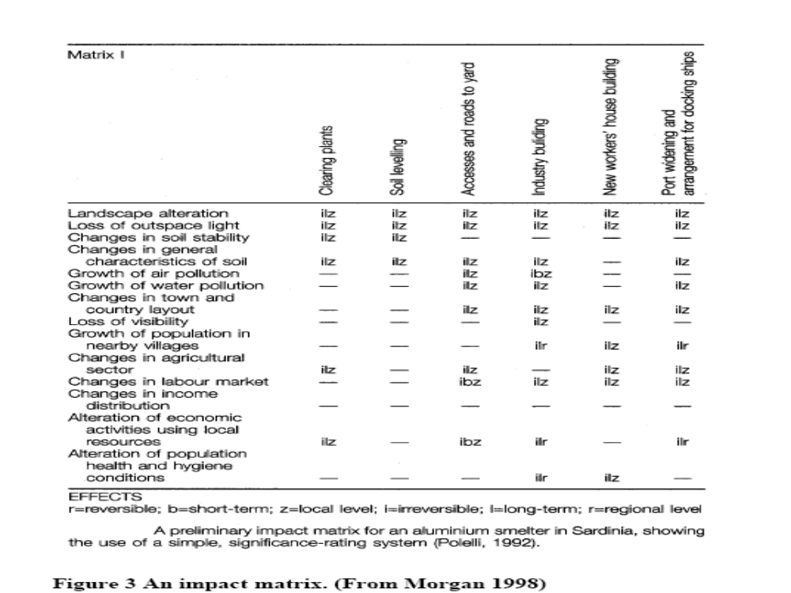

Slide 20
Public involvement
The degree of public involvement in EIA varies between different countries due to different legal reqirements as well as to tradition. In many countries like Sweden or the USA the public is supposed to have a large influence on the EIA process, while e g in Thailand the involvement is low. However, reality shows that public participation is often treated as a procedural exercise instead of a living process. (Shepard et al 1997). The contact with public often comes far too late in the process. (RRV 1996)
The importance of early communication with the public is essential to the success of an EIA and to the outcome of the proposed project. The public can be providing information into the process, regarding concerns to be recognised or considered or values to be reflected. Also in the procedural phase the public has a role as scrutinisers of the process, thereby encouraging better quality of the assessments. There are many examples of problems connected to public opinion against projects due to lack of communication during the planning and design process. However, there are also projects where an open dialogue between all parties involved has lead to situation where all see themselves as winners (Lindskog 1997).

Slide 21
The consideration of alternatives
Usually the consideration of alternatives is regarded as central in an EIA. Alternatives can be in locations, design alternatives or in means of implementation of a policy. There is also the "zero alternative" i e not to implement the proposal.
Risk and hazard assessment
EIA has elements of assessing risks, but not the common methodology of risk assessment. If the question is asked the risk of accidents etc may be included. Usually the RA treats more ofthe "unexpected" features like errors leading to catastrophes etc. Environmental Risk assessment (ERA) treats the effect of human activities on ecosystems. Hazard assessment treats the influence of natural catastrophes (earthquakes, landslides etc)

Slide 22
EIA and Decision-making
EIA is in itself a tool for decision-making. It is understood that the final report (EIS) is supposed to be used as a support for the decision-makers. However, decisions are taken at all stages during the EIA process and the result will be dependent on these decisions. All through screening and scoping decisions on what impacts to consider by developers who consult with the authorities and also rely on their own previous experience and professional judgement. (Weston 2000). This emphasises the need for a good documentation on the decisions takenduring the process, especially the rationale for not further investigating an impact or an alternative.

Slide 23
Thanks
Notes:
Thanks

